Slide 1

Lab 3 – Machine Learning
Notes:
IBM Big Data & Analytics © 2013 IBM Corporation
<number>

Slide 2
Spark Capabilities
Spark Core
Spark Streaming
Stream Processing
Micro-batch event processing for near real-time analytics
Process live streams of data (IoT, Twitter, Kafka)
No multi-threading or parallel processing required
Near real-time data processing & analytics
MLlib (machine learning)
Machine Learning
Predictive and prescriptive analytics, and smart application design, from statistical and algorithmic models
Algorithms are pre-built
Incredibly fast, easy to deploy algorithms
Spark SQL
Unified Data Access
Query your structured data sets with SQL or other dataframe APIs
Data mining, BI, and insight discovery
Get results faster due to performance
Fast, familiar query language for all data
Log processing
TBD
GraphX (graph)
Graph Analytics
Represent data in a graph
Represent/analyze systems represented by nodes and interconnections between them
Transportation, person to person relationships, etc.
Fast and integrated graph computation
Notes:
<number>

Slide 3
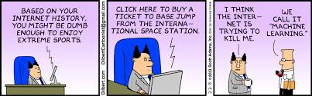
Machine Learning
In 1959, Arthur Samuel defined machine learning as a "Field of study that gives computers the ability to learn without being explicitly programmed"
Machine learning automates the development of analytical models that can learn and make predictions on data
Machine learning allows computers to find hidden insights without being explicitly programmed where to look

Slide 4

Machine Learning – A more formal definition
Tom Mitchell of Carnegie Mellon University provides a widely quoted, more formal definition of machine learning
"A computer program is said to learn from experience E with respect to some class of tasks T and performance measure P if its performance at tasks in T, as measured by P, improves with experience E"

Slide 5
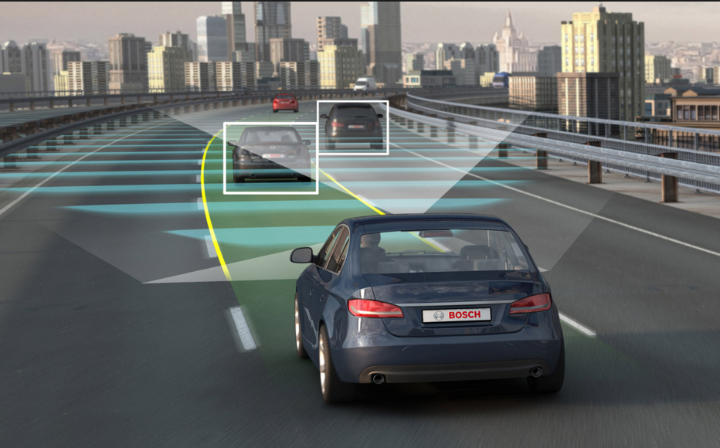
Machine Learning Examples
Online advertising
Detecting credit card fraud
Stock market forecasting
Medical diagnosis
Speech recognition
Self-driving cars

Slide 6
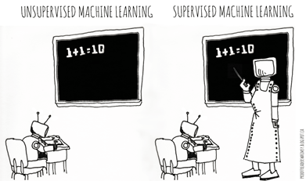
Categories of Machine Learning
Supervised learning
The program is “trained” on a pre-defined set of “training examples”, which then facilitate its ability to reach an accurate conclusion when given new data
The algorithm is presented with example inputs and their desired outputs (correct results)
The goal is to learn a general rule that maps inputs to outputs
Unsupervised learning
No labels are given to the learning algorithm, leaving it on its own to find structure (patterns and relationships) in its input
Unsupervised learning can be a goal in itself (discovering hidden patterns in data) or a means towards an end (feature learning)

Slide 7
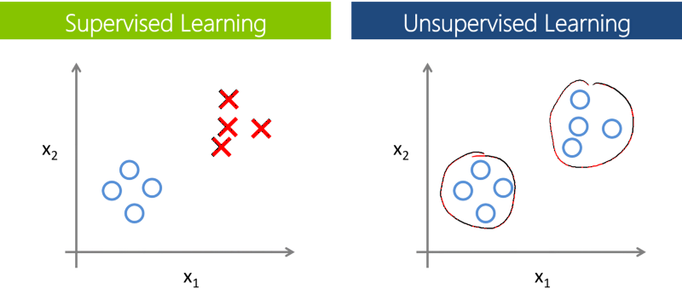
Supervised vs. Unsupervised Learning

Slide 8
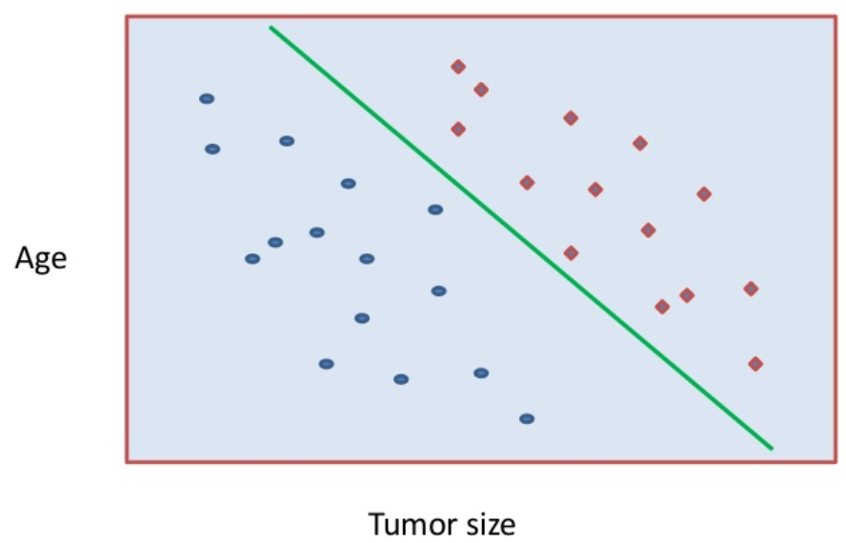
Example of Supervised Learning (Classification)
Goal is to make predictions

Slide 9
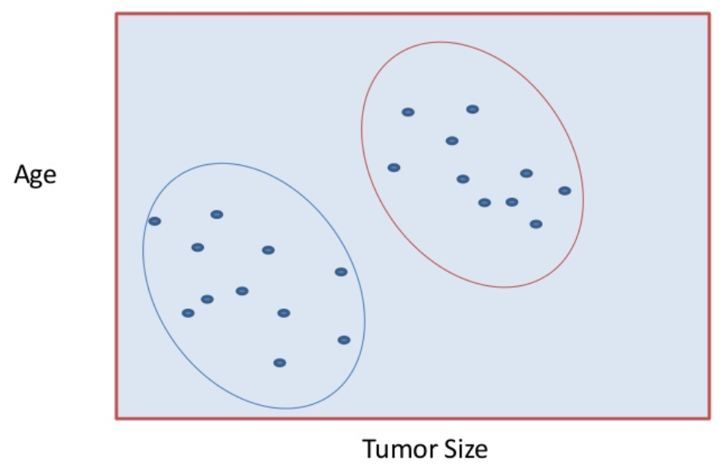
Example of Unsupervised Learning (Clustering)
Goal is to understand the structure of the data, not make predictions

Slide 10
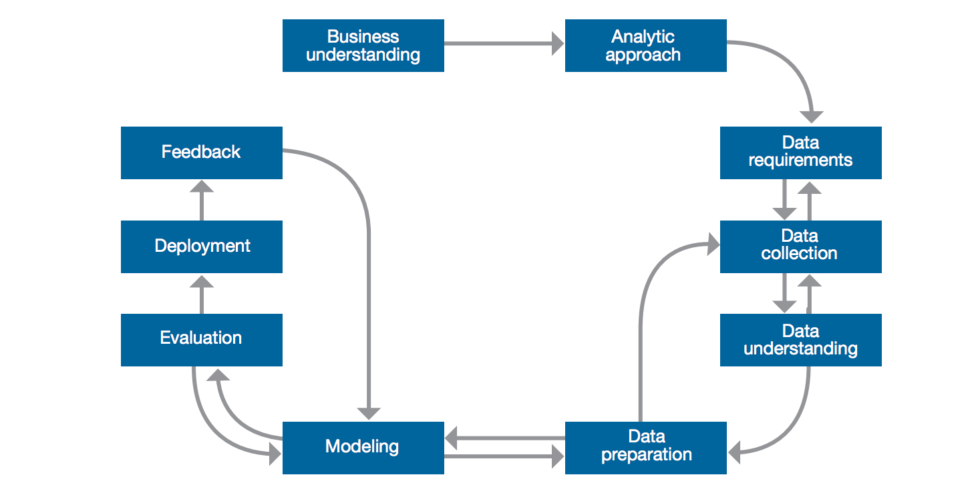
Typical Machine Learning Process and Pipeline
Beyond just the algorithms,, successful implementation of machine learning projects requires a process and rigor to achieve a useful result.

Slide 11
Spark ML
Spark ML is Spark’s machine learning (ML) library
Its goal is to make practical machine learning scalable and easy
Consists of common learning algorithms and utilities, including
Classification
Regression
Clustering
Collaborative filtering
Dimensionality Reduction
Lower-level optimization primitives
Higher-level pipeline APIs

Slide 12

Spark ML
Divides into two packages:
spark.mllib contains the original API built on top of RDDs
spark.ml provides higher-level API built on top of DataFrames for constructing ML pipelines
Using spark.ml is recommended because with DataFrames the API is more versatile and flexible
spark.mllib will continue to be supported

Slide 13
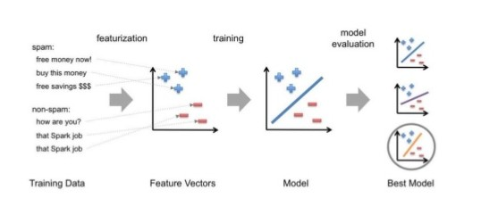
Typical Steps in ML Pipeline

Slide 14

Recommendation Systems
Recommendation systems seek to predict the rating (or preference) that a user would give to an item
Recommendation systems attempt to improve customer experience through personalized recommendations based on prior user feedback
Recommender systems have become extremely common in recent years, and are applied in a variety of applications
movies, music, news, books, research articles, search queries, social tags, …
products in general
Collaborative filtering is a technique that is commonly used for recommender systems
employs a form of wisdom of the crowd approach

Slide 15
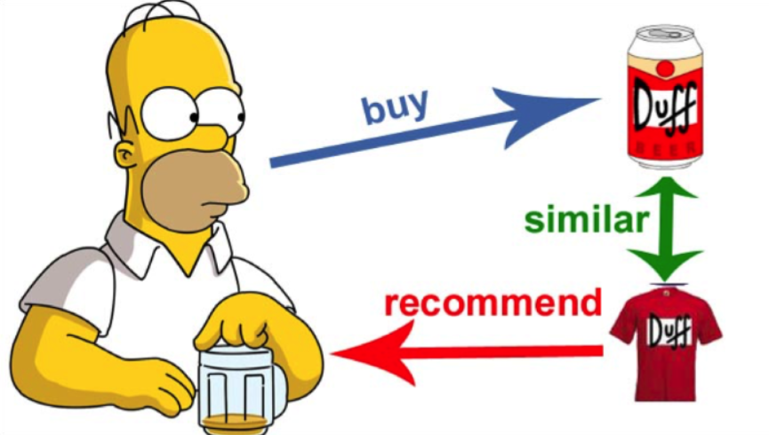
Collaborative Filtering with Spark ML
Forms of Collaborative Filtering
Explicit matrix factorization - preferences provided by users themselves are utilized
Implicit matrix factorization - only implicit feedback (e.g. views, clicks, purchases, likes, shares etc.) is utilized
Spark ML supports an implementation of matrix factorization for collaborative filtering
Matrix factorization models have consistently shown to perform extremely well for collaborative filtering
Collaborative filtering aims to fill in the missing entries of a user-item association matrix in which users and items are described by a small set of latent factors that can be used to predict missing entries
Notes:
<number>

Slide 16
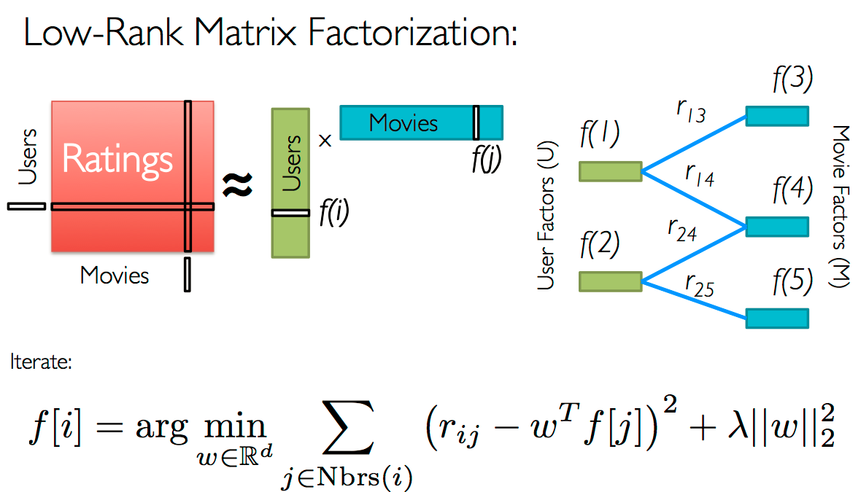
Alternating Least Squares (ALS) Algorithm
Spark ML uses the Alternating Least Squares (ALS) algorithm to learn the latent factors for the matrix factorization problem
ALS works by iteratively solving a series of least square regression problems to derive a model

Slide 17
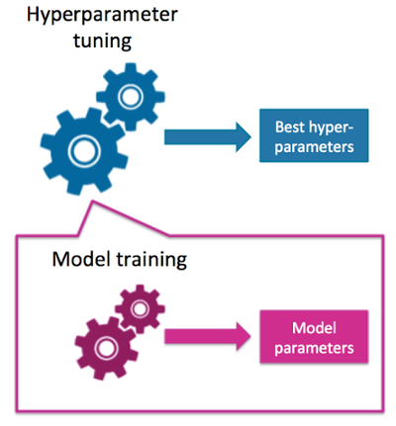
Tuning a Spark ML Model - Hyperparameters
Spark ML algorithms provide many hyperparameters for tuning models
These hyperparameters are distinct from the model parameters being optimized by ML itself
Hyperparameter tuning is accomplished by choosing the best set of parameters based on model performance on test data that the model was not trained with

Slide 18

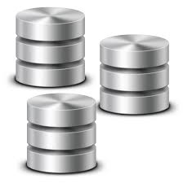
Lab 3 Flow
Download compressed CSV data and load into an RDD
Prepare the data
Remove header
Only keep rows that have
a purchase quantity greater than 0
a non blank customer ID
a non blank stock code after removing non-numeric characters
4. Create a DataFrame from the resulting RDD
Add a label column
5. Split the dataset
80% for training
10% for testing
10% for cross validation

Slide 19

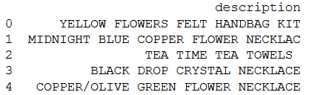

Lab 3 Flow (continued)
Build a recommendation model using the training dataset
Two models using different hyperparameters
rank
maxIter
Test the two models using the cross validation dataset
Evaluate the two models using mean squared error
Confirm “best” model against the test dataset
Use the “best” model to make predictions for a particular user
Top 5 recommendations

